Slide 1
BUILDOTS UPDATE : 05/01/2020

Slide 2
SUMMARY
Attempt for 10 experiments at 30 FPS, testing for the double circle path, excessive run time (FOV 2000px 30FPS double circled : over 28 hours run time… not feasible.
Redirected to 4 experiments at 10 FPS, CLOSE setting: check improvement using double circled path at 1000px and 2000px for FOV and SIMPLE_RADIAL_FISHEYE camera models.

Slide 3
EXPERIMENTS INDEX
FAR
1 CLOSE 2000 FOV
2 CLOSE 2000 SIMPLE_RADIAL_FISHEYE
3 CLOSE 1000 FOV
4 CLOSE 1000 SIMPLE_RADIAL_FISHEYE

Slide 4
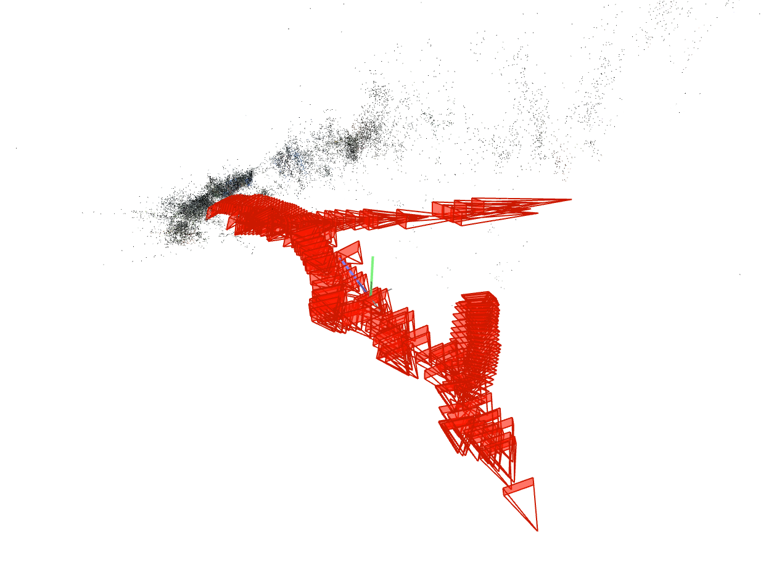
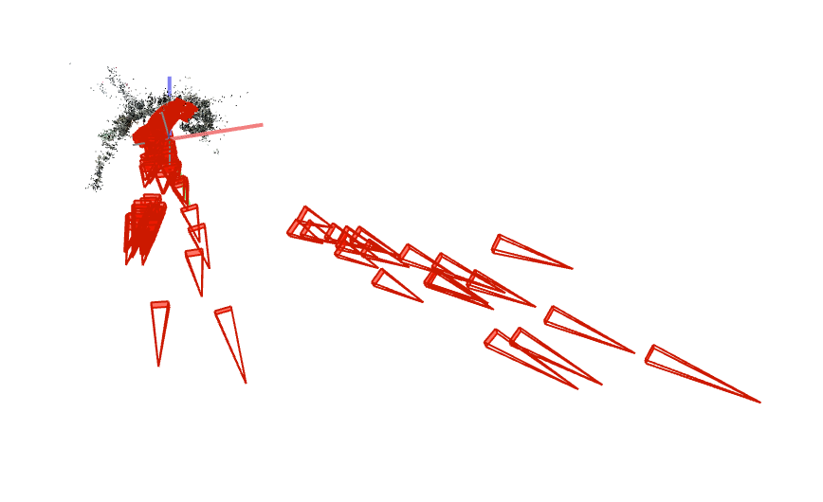
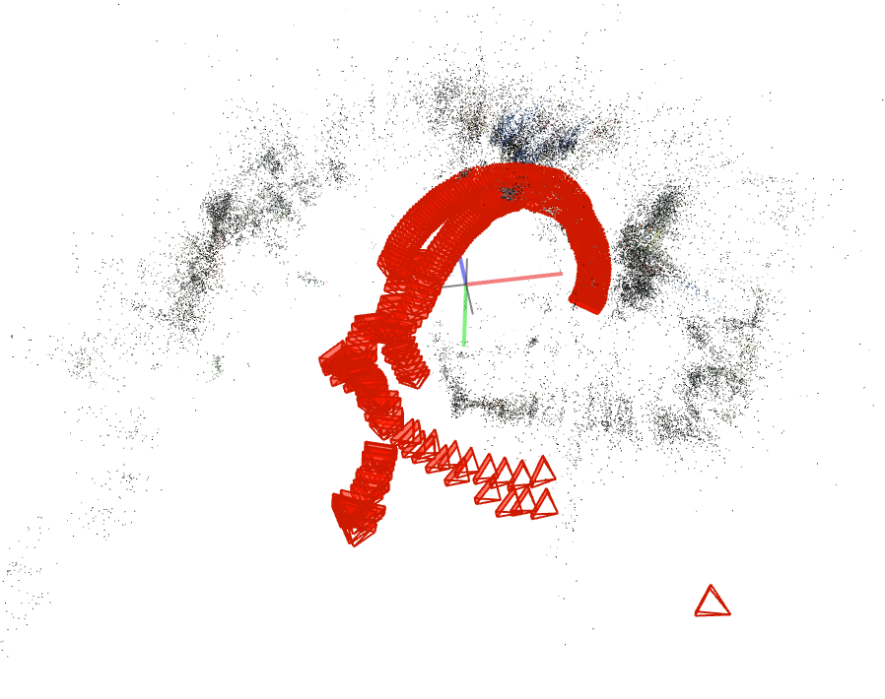
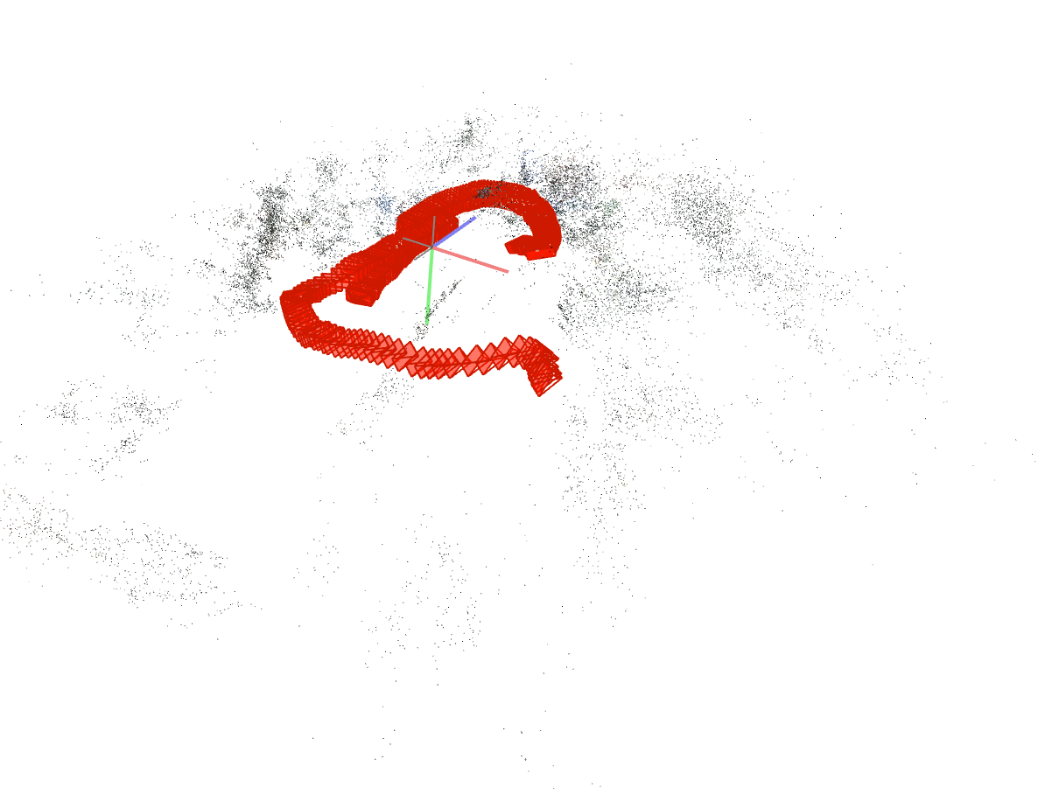
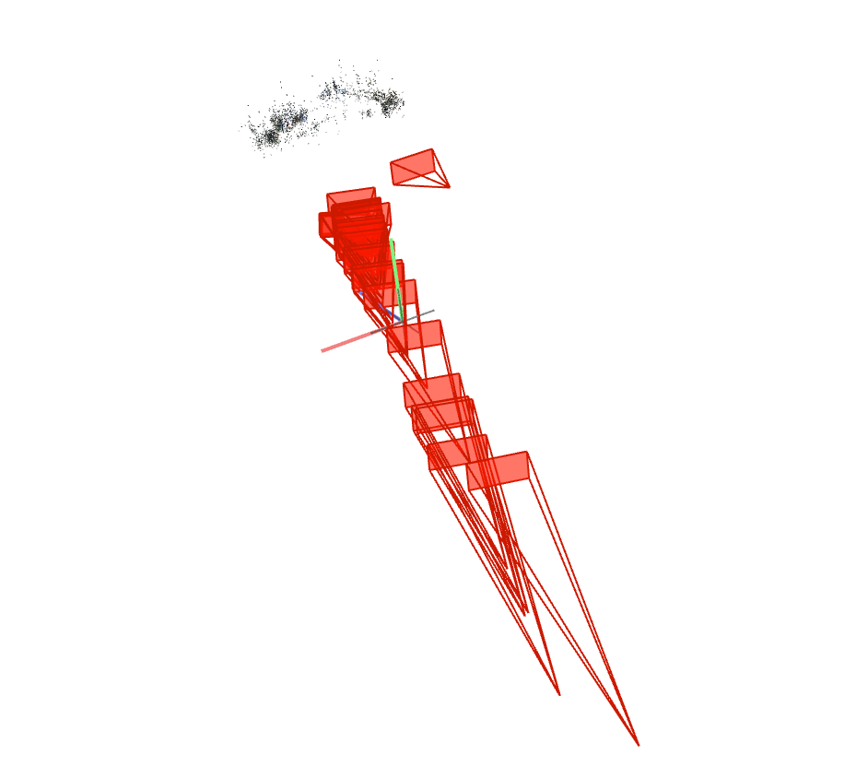
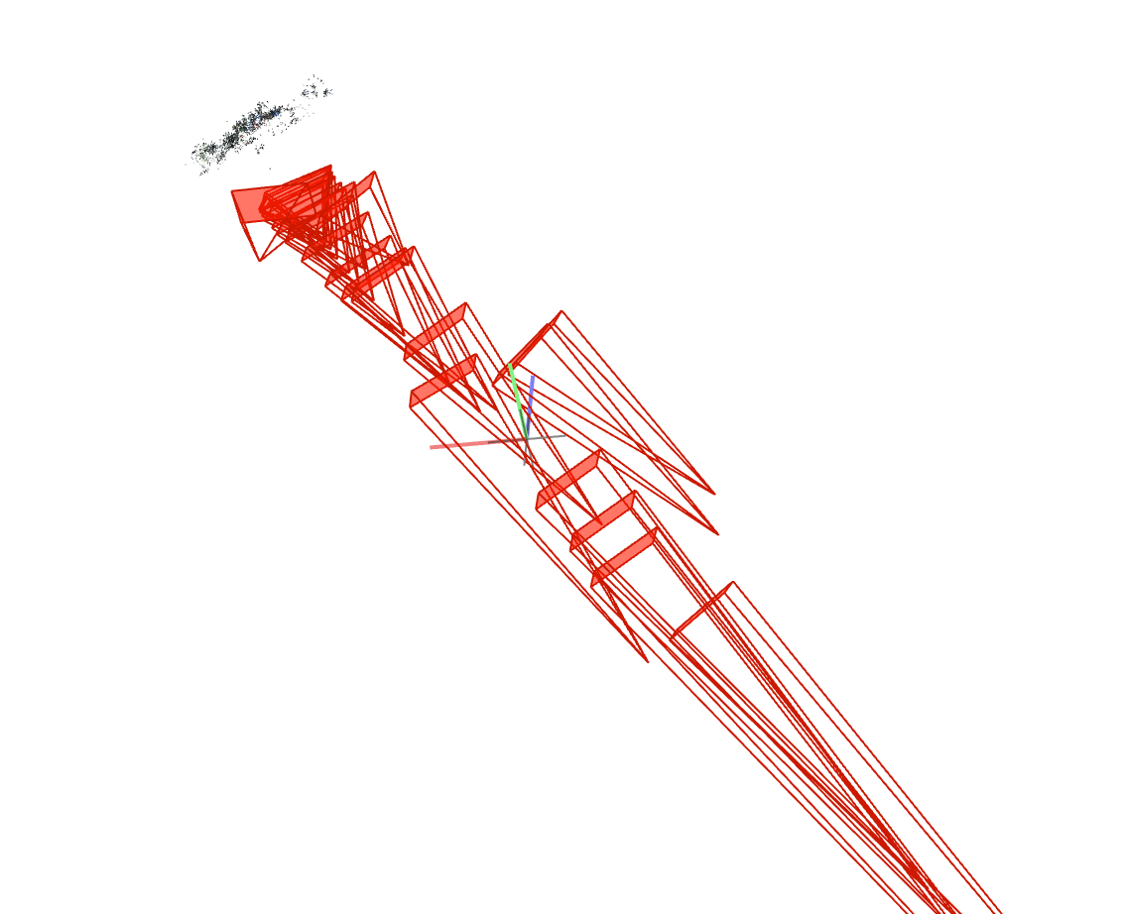
PREVIEW : CLOSE, 2000px
FOV 1 Sparse model | SIMPLE_RADIAL_FISHEYE 1 Sparse model
FOV 3 Sparse models | SIMPLE_RADIAL_FISHEYE 1 Sparse model
Doubled circled
Single circled

Slide 5
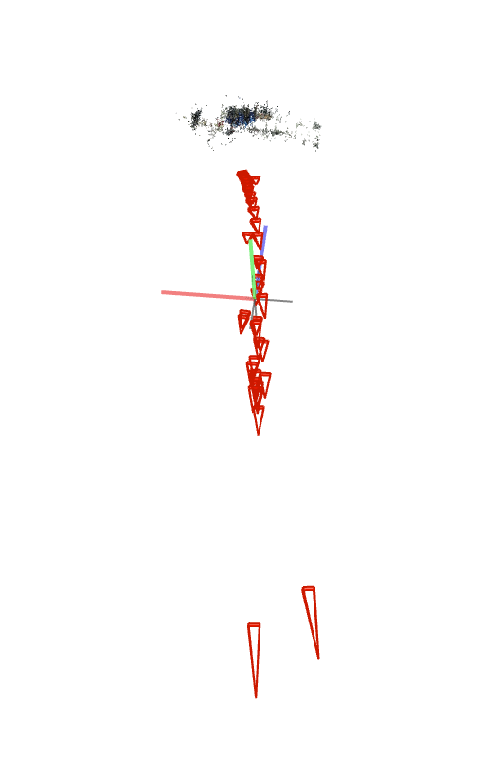
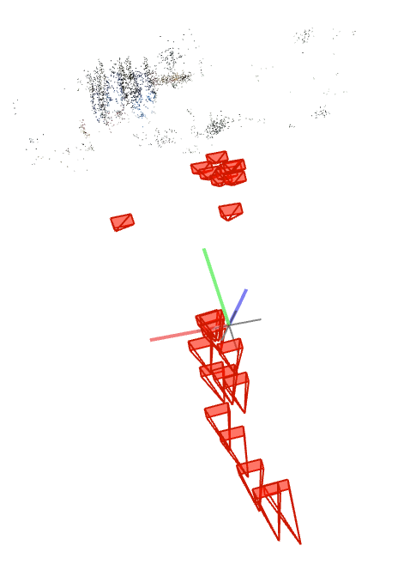
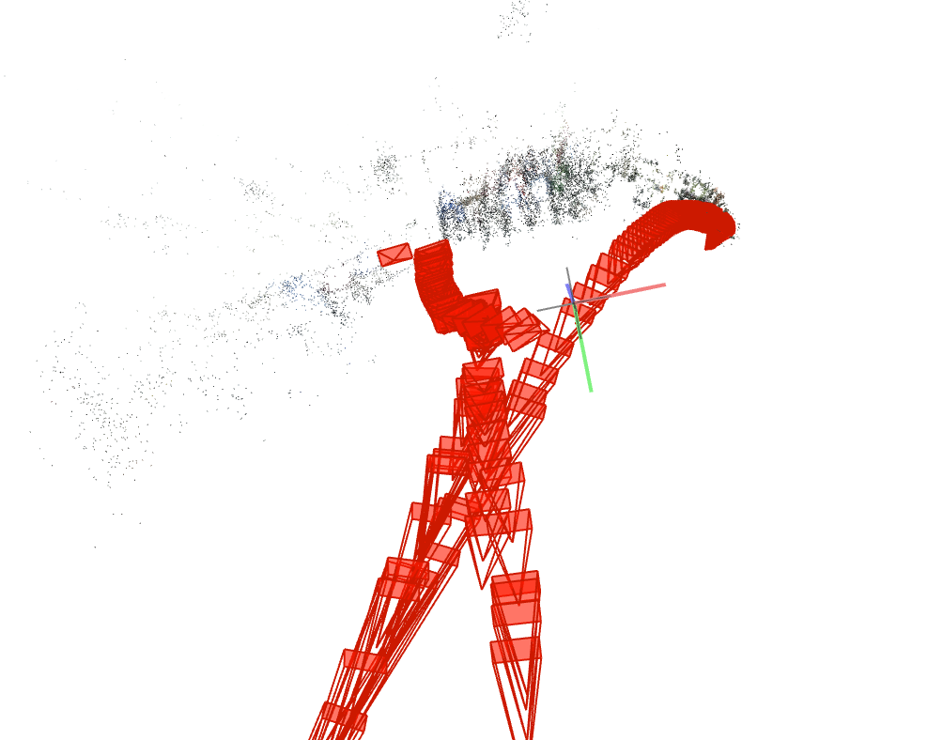
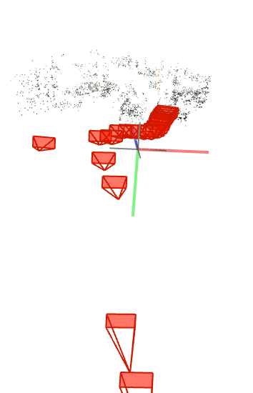
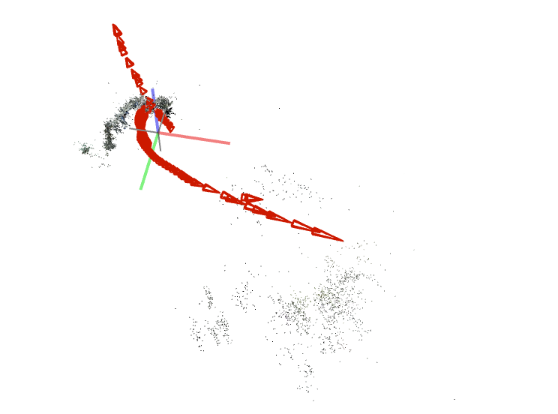
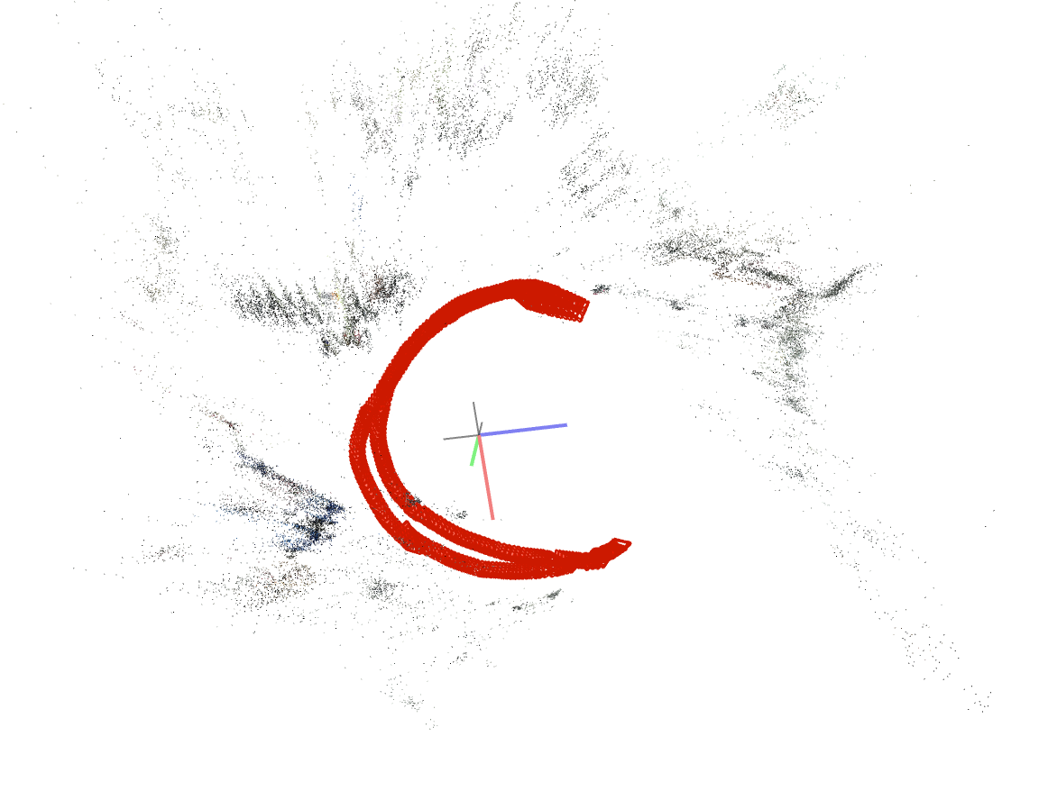
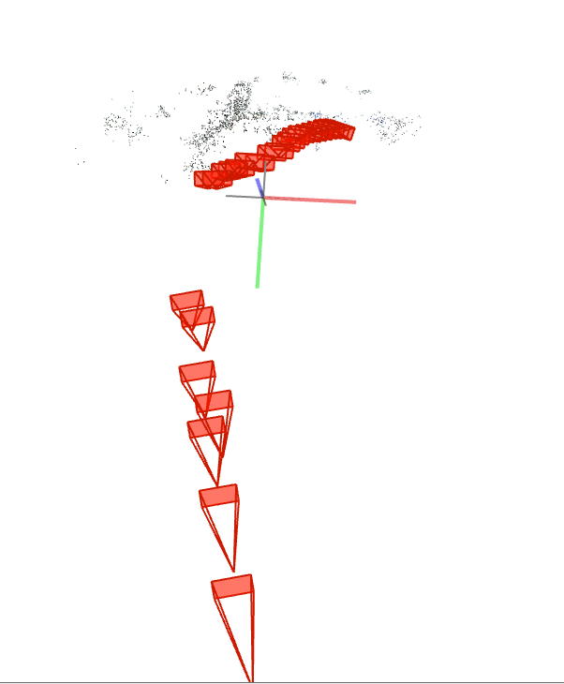
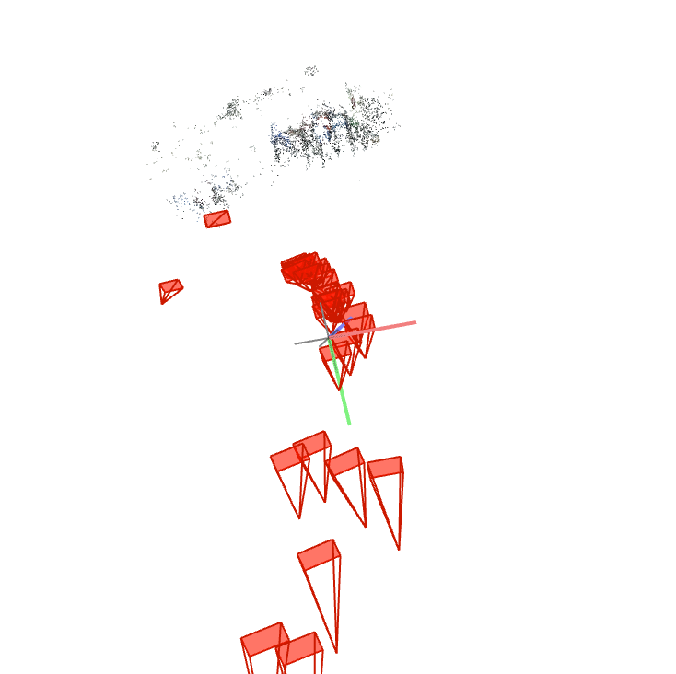
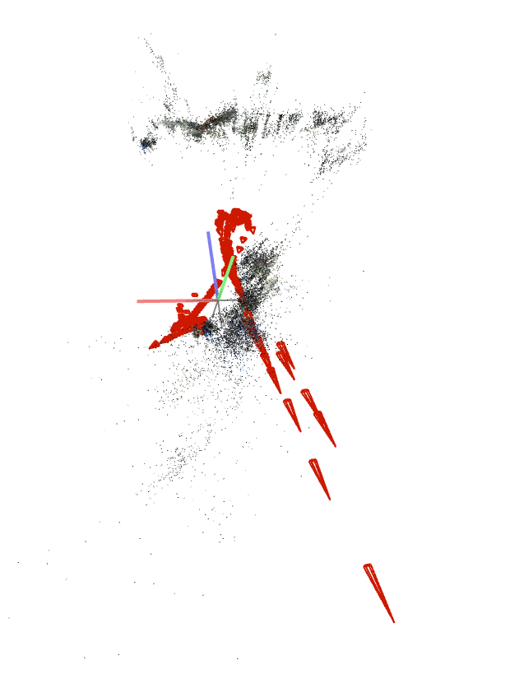
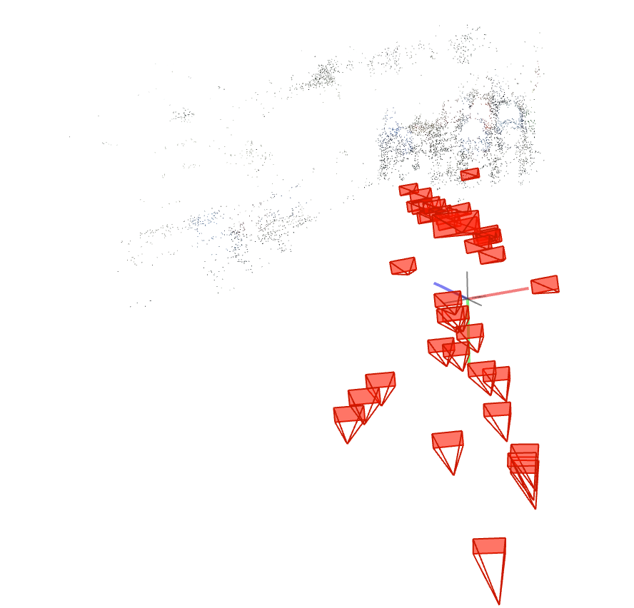
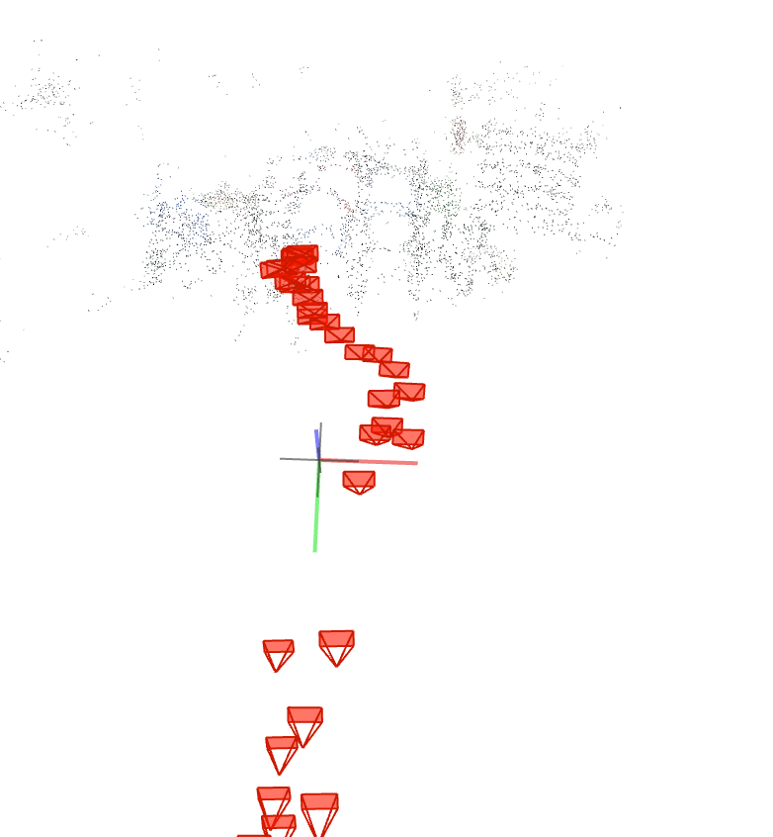
PREVIEW : CLOSE, 1000px
FOV 12 Sparse models | SIMPLE_RADIAL_FISHEYE 1 Sparse model
FOV 6 Sparse models | SIMPLE_RADIAL_FISHEYE 1 Sparse model
Doubled circled
Single circled

Slide 6
CONCLUSION
Cropping the original frames into 1000 and 2000px wide frames has the SIMPLE_RADIAL_FISHEYE camera model to recontruct the poses path better than the other camera models
We have similar dense reconstruction details for SIMPLE_RADIAL_FISHEYE 1000 and 2000px, but a better poses path for 1000px
Next steps :
Experiment for 10 FPS SIMPLE_RADIAL_FISHEYE vs 4 other cameras model
Experiment for 20 FPS SIMPLE_RADIAL_FISHEYE vs 4 other cameras model
Reproducing Jonathan experiment with our dataset (buildots extraction and calibration + default sfm parameters)

Slide 7
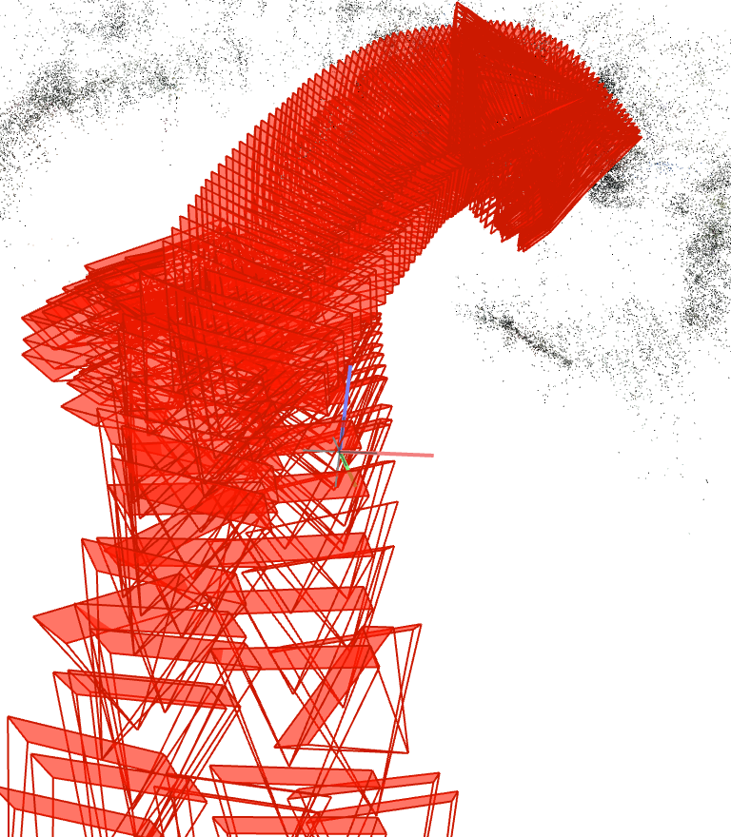
Experiment 1
FPS : 10
# Frames : 356
Record length : 36 [s]
Camera distance model : CLOSE
Frame size : 2000
Camera model : FOV
Sparse models : 1
Notes: We can see many frames from different circles, overlapping for poses with greater texture content.

Slide 8
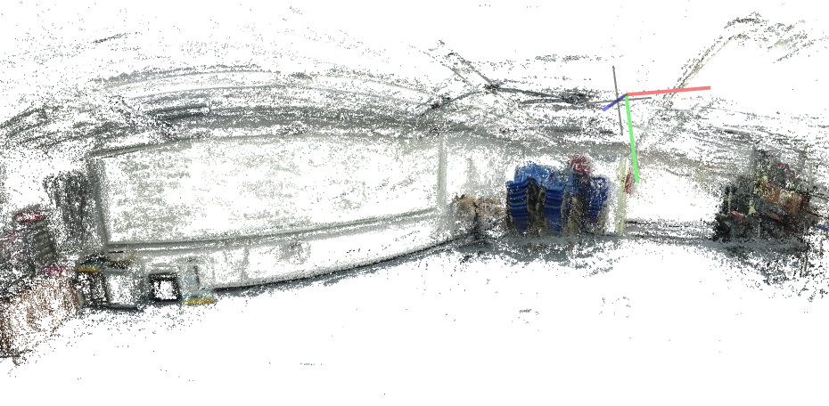
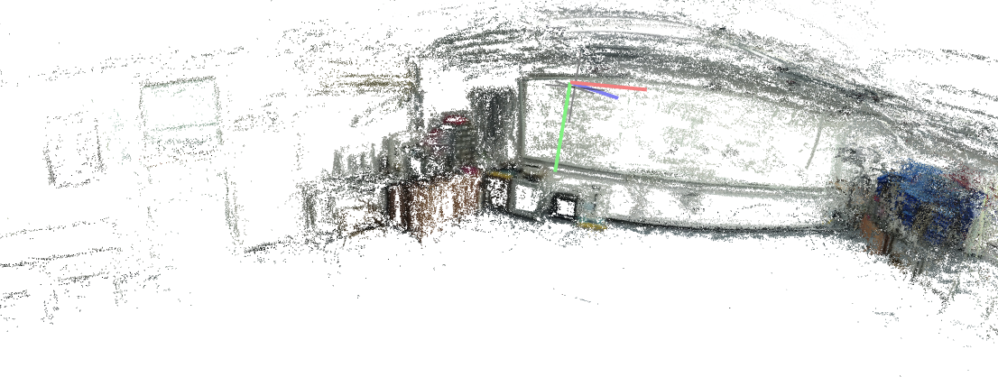
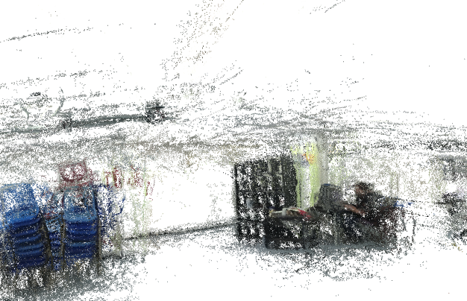
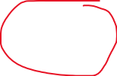
DENSE RECONSTRUCTION
FPS : 10
# Frames : 356
# Frames used : 340
Record length : 36 [s]
Camera distance model : CLOSE
Frame size : 2000
Camera model : FOV
Notes : We start seeing finer details such as white board, fire estinguisher and ceiling rails. A Larger portion of the room has been reconstructed.

Slide 9
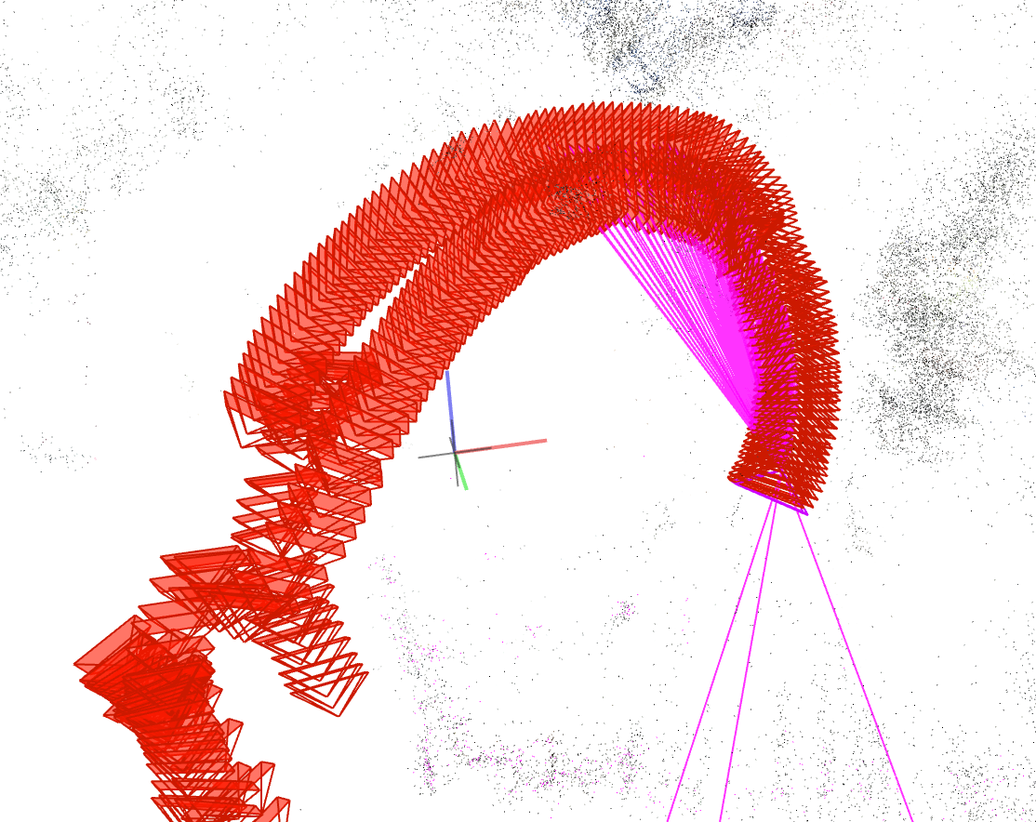
Experiment 2
FPS : 10
# Frames : 356
Record length : 36 [s]
Camera distance model : CLOSE
Frame size : 2000
Camera model : SIMPLE_RADIAL_FISHEYE
Sparse model : 1
Notes: We can clearly see a circled path now. The camera poses are more precise in area with greater texture. This model of camera seems more suitable than the FOV in term of camera poses. Also, it appears that this model found more feature points than the FOV

Slide 10
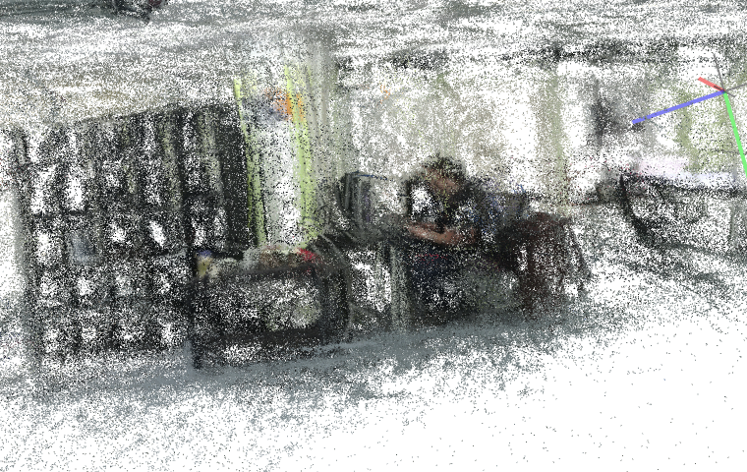
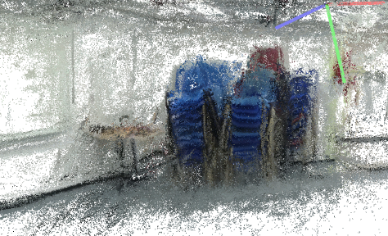
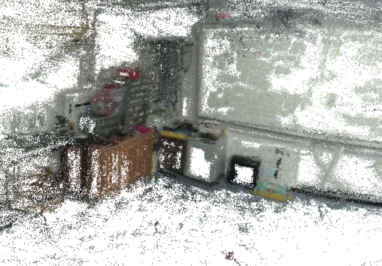
DENSE RECONSTRUCTION
FPS : 10
# Frames : 356
# Frames used : 356
Record length : 36 [s]
Camera distance model : CLOSE
Frame size : 2000
Camera model : SIMPLE_RADIAL_FISHEYE
All frames used for reconstruction, more details (people appearance)

Slide 11
Experiment 3
FPS : 10
# Frames : 356
Record length : 36 [s]
Camera distance model : CLOSE
Frame size : 1000
Camera model : FOV
Sparse models : 12

Slide 12
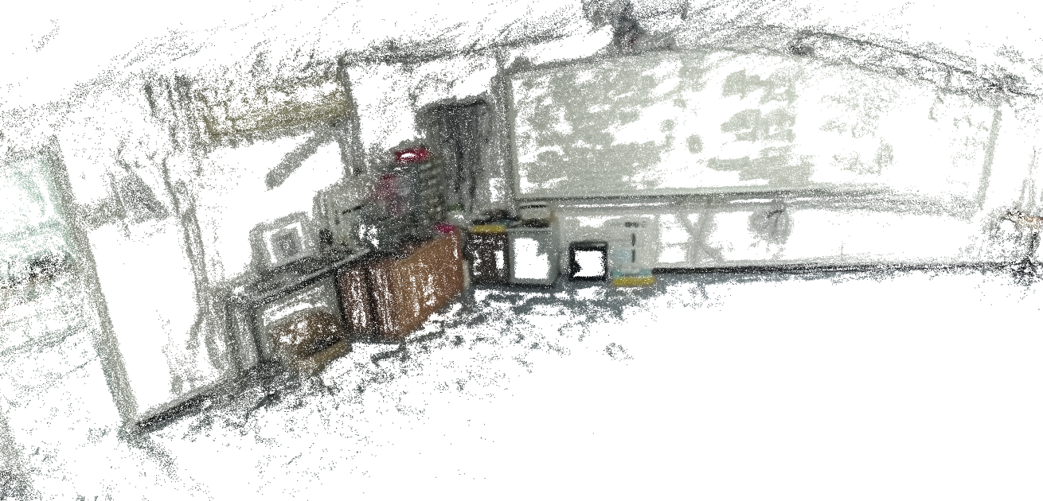
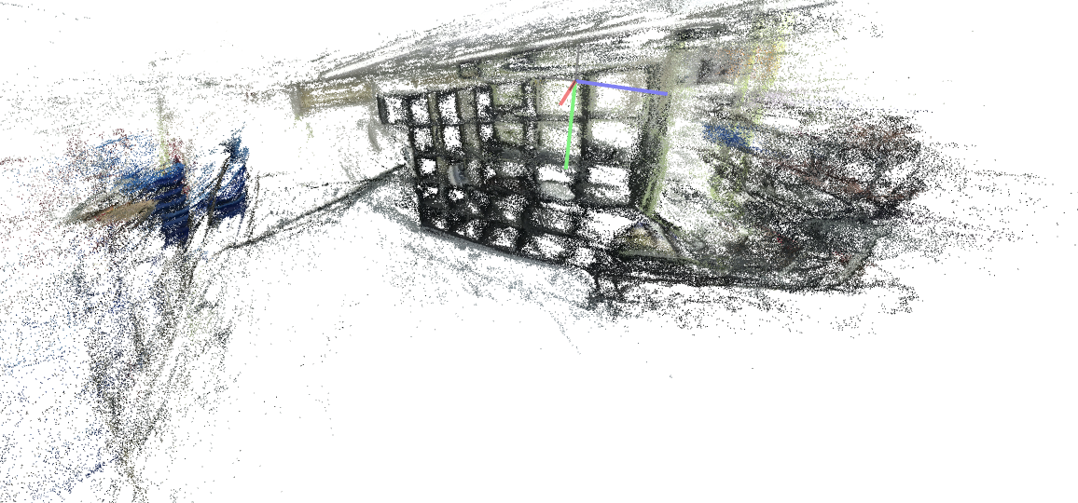
DENSE RECONSTRUCTION
FPS : 10
# Frames : 356
# Frames used : 266
Record length : 36 [s]
Camera distance model : CLOSE
Frame size : 1000
Camera model : FOV
Poor reconstruction except for starting point

Slide 13
Experiment 4
FPS : 10
# Frames : 356
Record length : 36 [s]
Camera distance model : CLOSE
Frame size : 1000
Camera model : SIMPLE_RADIAL_FISHEYE
Sparse model : 1
A complete circle with all the frames, correct trajectory but fail to understand that beginning == end

Slide 14
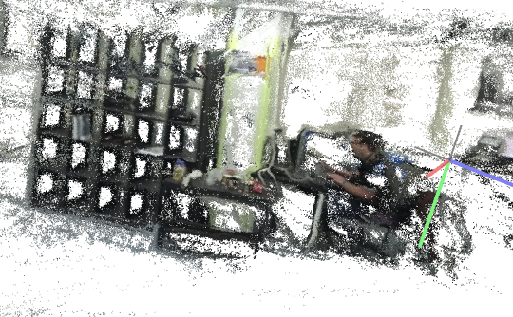
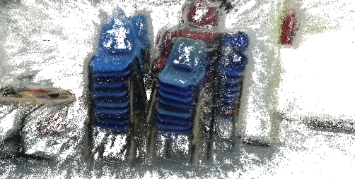
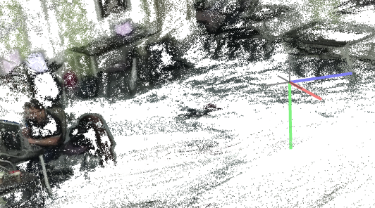
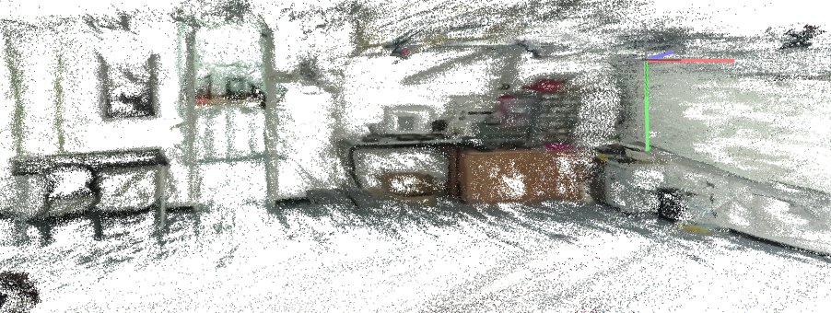
DENSE RECONSTRUCTION
FPS : 10
# Frames : 356
# Frames used : 356
Record length : 36 [s]
Camera distance model : CLOSE
Frame size : 1000
Camera model : SIMPLE_RADIAL_FISHEYE
All frames used for reconstruction, more details (people appearance)

Slide 15
APPENDIX: SCRIPTS USED
Colmap_experiment.sh
DATASET_PATH=$1
colmap feature_extractor --database_path $DATASET_PATH/database.db --image_path $DATASET_PATH/images --ImageReader.camera_model $2
colmap exhaustive_matcher \
--database_path $DATASET_PATH/database.db
mkdir $DATASET_PATH/sparse
colmap mapper \
--database_path $DATASET_PATH/database.db \
--image_path $DATASET_PATH/images \
--output_path $DATASET_PATH/sparse
mkdir $DATASET_PATH/dense
colmap image_undistorter \
--image_path $DATASET_PATH/images \
--input_path $DATASET_PATH/sparse/0 \
--output_path $DATASET_PATH/dense \
--output_type COLMAP \
--max_image_size 2000
colmap patch_match_stereo \
--workspace_path $DATASET_PATH/dense \
--workspace_format COLMAP \
--PatchMatchStereo.geom_consistency true
colmap stereo_fusion \
--workspace_path $DATASET_PATH/dense \
--workspace_format COLMAP \
--input_type geometric \
--output_path $DATASET_PATH/dense/fused.ply
Extract_frames.py
import sys
import os
import cv2
_VIDEO_PATH = sys.argv[2]
_FRAMES_DIR = sys.argv[3]
_OUTPUT_HEIGHT = 2160
_OUTPUT_WIDTH = 2 * _OUTPUT_HEIGHT
_FPS = int(sys.argv[1])
def main():
os.makedirs(_FRAMES_DIR, exist_ok=True)
cap = cv2.VideoCapture(_VIDEO_PATH)
frame_idx = -1
while True:
frame_idx += 1
cap.set(cv2.CAP_PROP_POS_MSEC,(frame_idx*(1000/_FPS))) #gets a frame every 1000[ms]/_FPS_
offset_ms = cap.get(cv2.CAP_PROP_POS_MSEC)
print(f"frame_{frame_idx:04}_FPS:{_FPS}.jpg")
ret, cur_frame = cap.read()
if not ret:
return
offset_ms = int(offset_ms)
cur_frame = cv2.resize(cur_frame, (_OUTPUT_WIDTH, _OUTPUT_HEIGHT))
output_path = os.path.join(_FRAMES_DIR, f"frame_{frame_idx:04}_FPS:{_FPS}.jpg")
cv2.imwrite(output_path, cur_frame)
if __name__ == "__main__":
main()

Slide 16
APPENDIX: SCRIPTS USED (2)
Crop_frames.py
Import sys
import os
import numpy as np
from PIL import Image
_FRAMES_DIR = sys.argv[3]
_CROP_DIR = sys.argv[4]
_FOV_WIDTH = np.radians(100)
_FOV_HEIGHT = np.radians(62)
_CROP_WIDTH = int(sys.argv[2])
_CROP_HEIGHT = int(round(np.tan(_FOV_HEIGHT/2) / np.tan(_FOV_WIDTH/2) * _CROP_WIDTH))
_FPS = int(sys.argv[1])
def crop_center(pil_img, crop_width, crop_height):
img_width, img_height = pil_img.size
return pil_img.crop(((img_width - crop_width) // 2,
(img_height - crop_height) // 2,
(img_width + crop_width) // 2,
(img_height + crop_height) // 2))
def main():
os.makedirs(_CROP_DIR, exist_ok=True)
fidx = -1
for file in sorted(os.listdir(_FRAMES_DIR)): # sorted() forcing python to keep the frame order, otherwise random
if file.endswith(".jpg"): # avoid working with hidden files
fidx += 1
print(fidx)
print(file)
frame = Image.open(os.path.join(_FRAMES_DIR, file))
rect = crop_center(frame, _CROP_WIDTH, _CROP_HEIGHT)
filename = (f"frame_{fidx:04}_FPS:{_FPS}_cropped.jpg")
file_path = os.path.join(_CROP_DIR, filename)
print(filename)
rect.save( file_path )
if __name__ == "__main__":
main()

